Slide 1
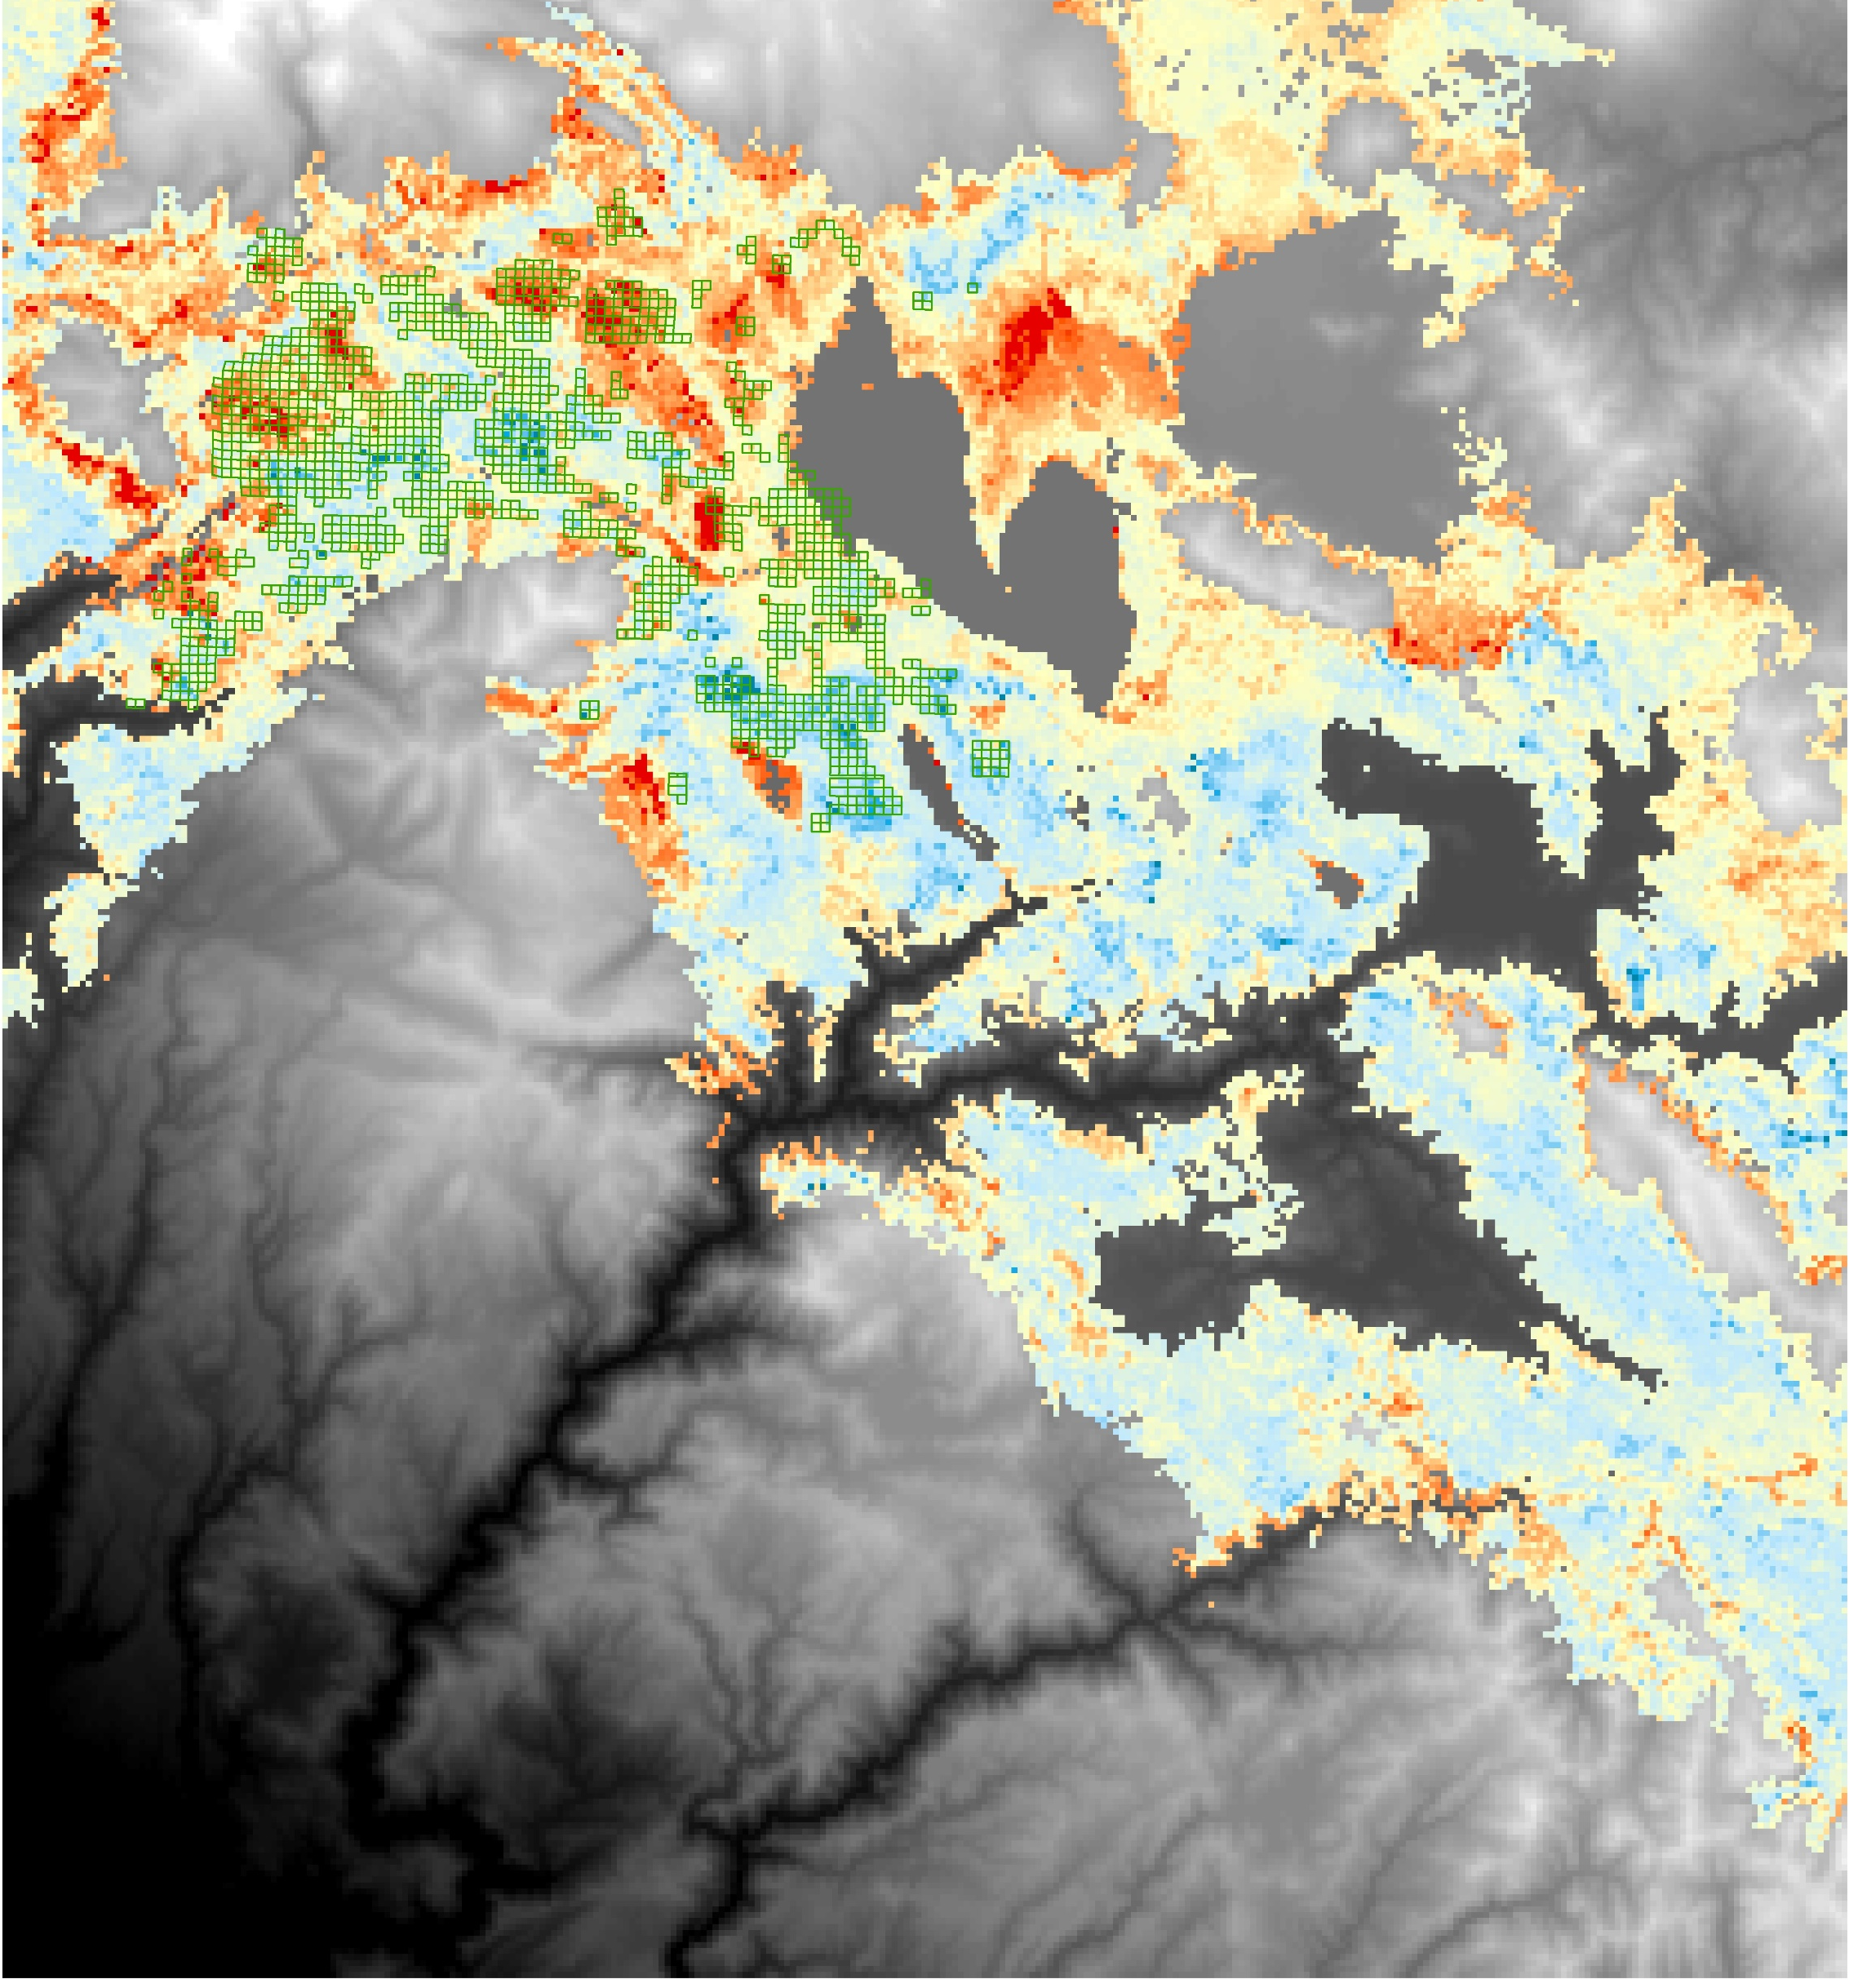
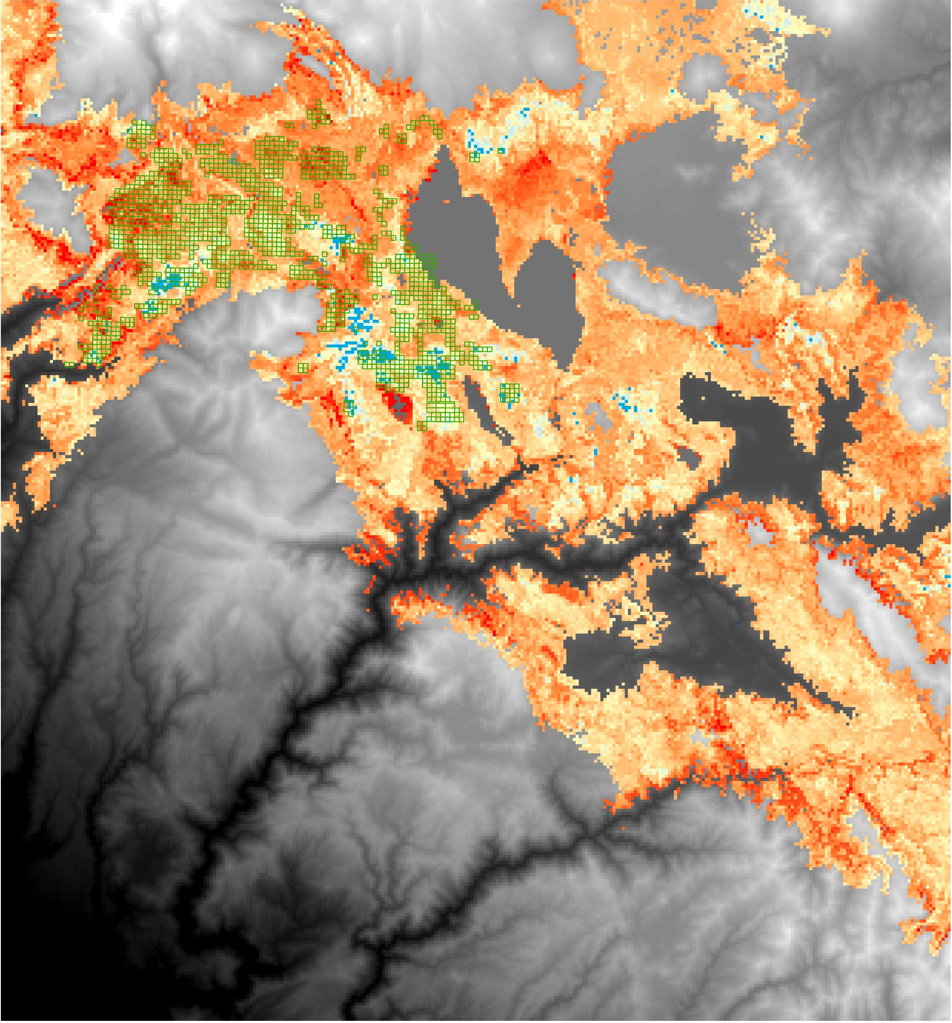
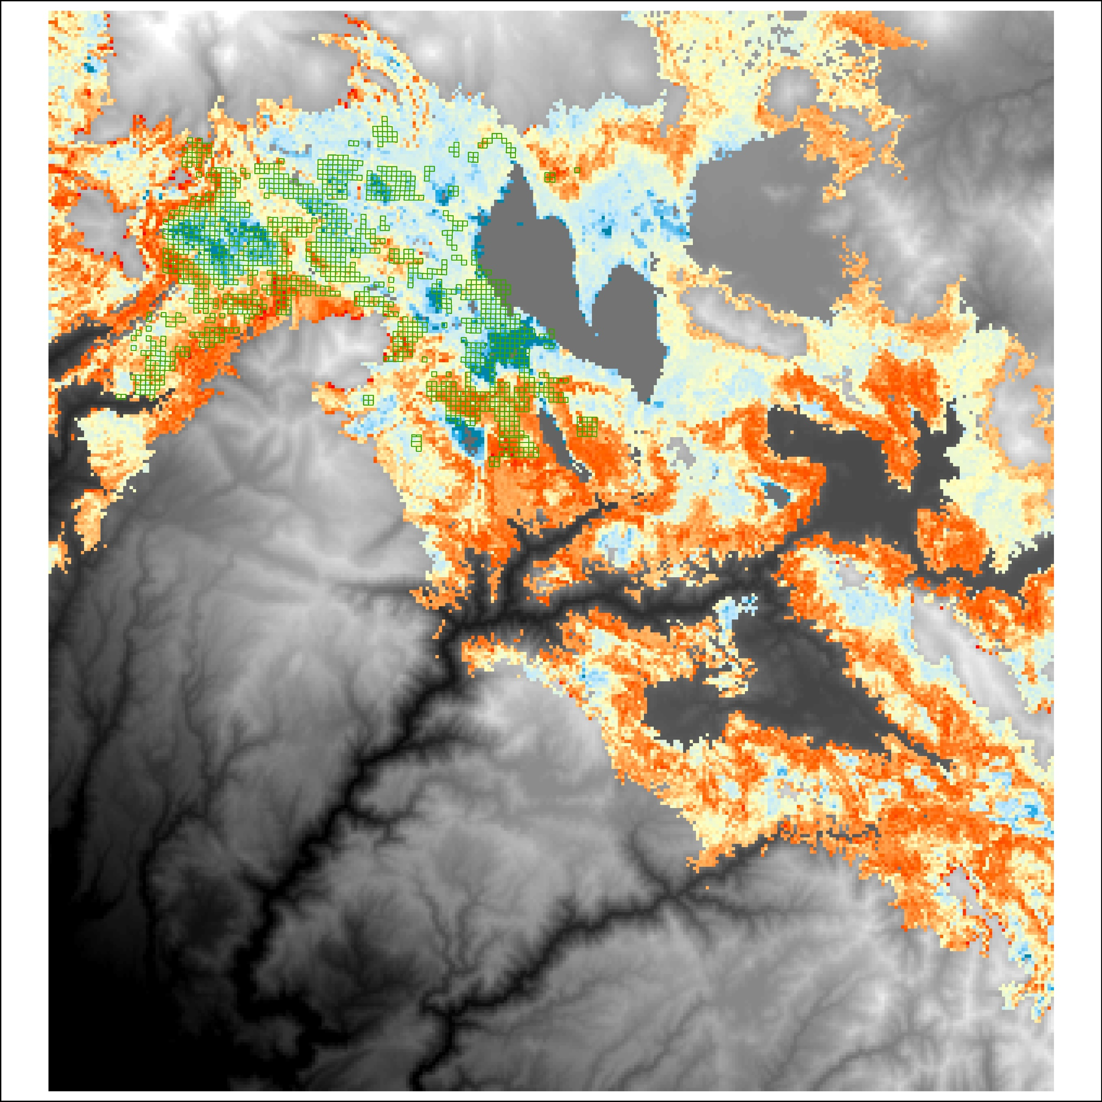
Sampled QQs
Sampled QQs
Predicted TPH
Predicted BA
(m² ha⁻¹)
21
31
9
41
14
51
19
61
24
68
26
Elevation (m)
Elevation (m)
0
2736
0
2736
Sampled QQs
Predicted pine fraction
0.38
0.50
0.61
0.73
0.84
0.96
Elevation (m)
0
2736

